Slide 1
Construction Site Safety Risk Mitigation System Using RAG-Enhanced LLMs
Civil and Environmental Engineering
Hyun Lee, Jaeho Park, Jeongkyu Lee, Jeongmin Yun

Slide 2

CONTENTS
Background of project
Current Challenges
Project Objectives
Datasets
Application Overview
Service Architecture
Technology Stack
Expectations
Future works

Slide 3
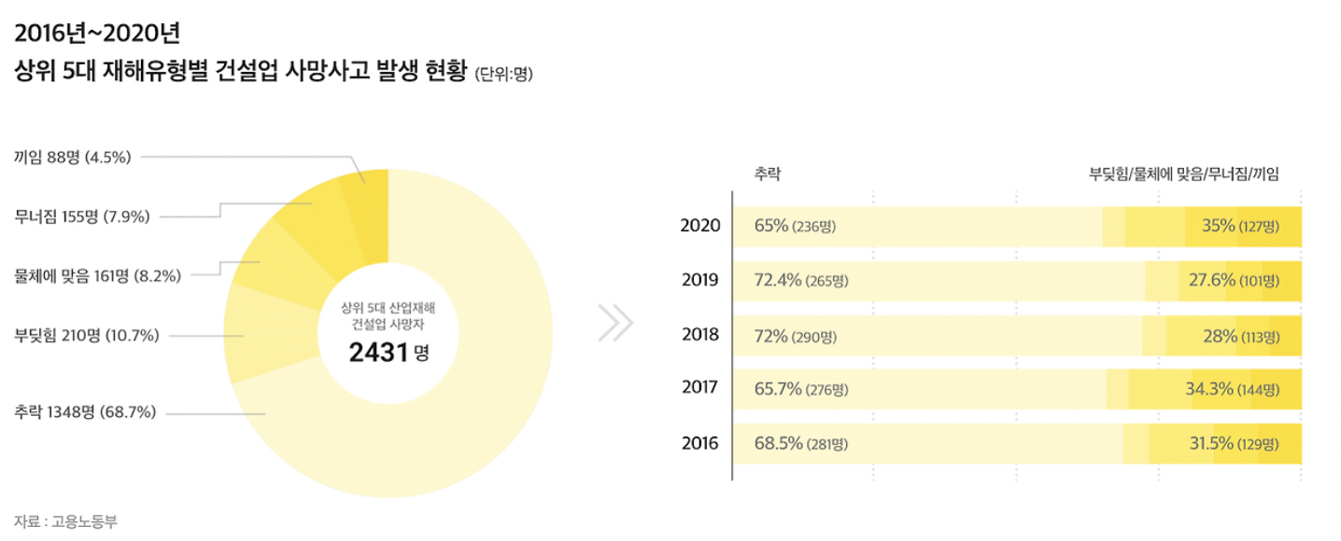
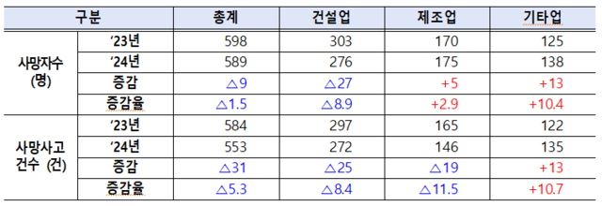
Background of project
“The problems at construction sites remain unresolved.”
Reduction in the number of fatalities and fatal accidents in the construction industry
Safety improvements are not the only reason for this decline
Partly driven by a slowdown in construction activity, leading to few incidents
고용노동부, 2025년 3월 11일 보도자료 “2024년 재해조사 대상 사고사망자 발생 현황

Slide 4
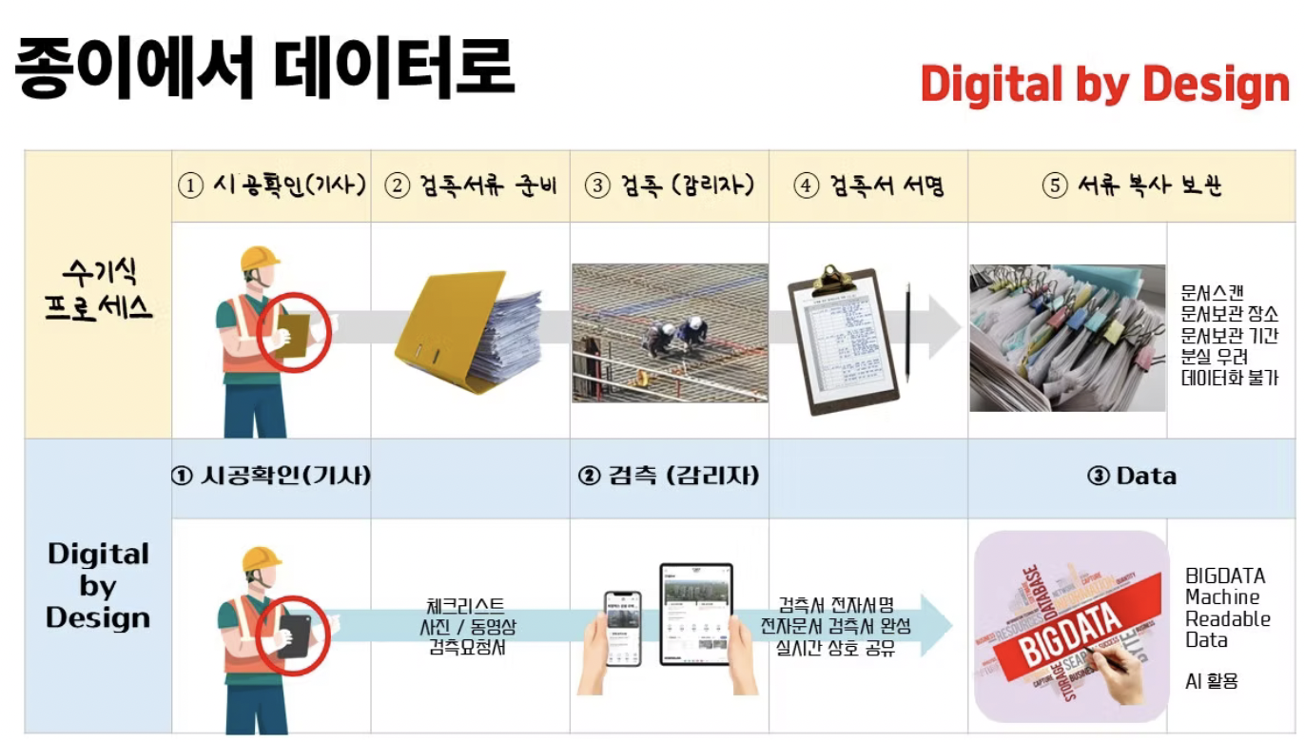
Background of project
“The problems at construction sites remain unresolved.”
Passive approach
- Massive paperwork transfers
- Inability to check reference information in real-time
- Leads to delays
- Risk of false reporting
Digital Transformation
- Ensuring objectivity
- Enhancing transparency
- Real-time feedback and collaboration
- Improving work efficiency and record management
https://kism.or.kr/file/memoir/6_4_6.pdf?utm_source
https://economist.co.kr/article/view/ecn202304240061?utm_source
https://www.conup.co.kr/post/부실감리와-허위보고서-수기식-감리체계의-한계를-디지털로-넘어서라?utm_source

Slide 5
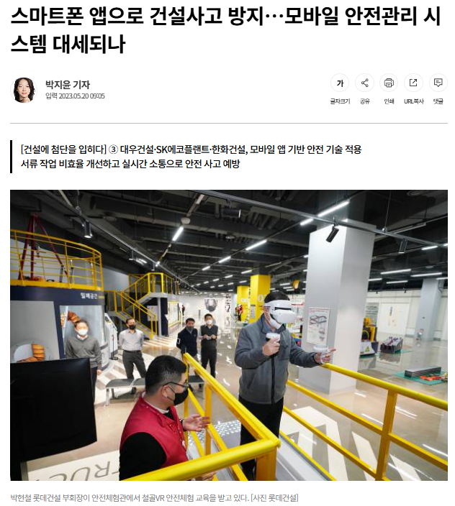
Background of project
Breakdown of Communication
between on-site workers and managers
Inaccurate data, delayed reporting, and poor communication cost the construction industry over $3.13 billion each year
Nearly one-third of all project failures are directly linked to poor communication across teams
Real-time alerts from field workers to headquarters can reduce hazard response times by up to 70%
https://economist.co.kr/article/view/ecn202304240061?utm_source
https://esub.com/blog/communication-in-construction?utm_source
https://cembs.com/impact-of-effective-data-sharing-and-communication-in-construction/?utm_source

Slide 6
Background of project
“The problems at construction sites remain unresolved.”
In other words, the absence of a real-time hazard communication and information feedback system remains a critical issue.

Slide 7
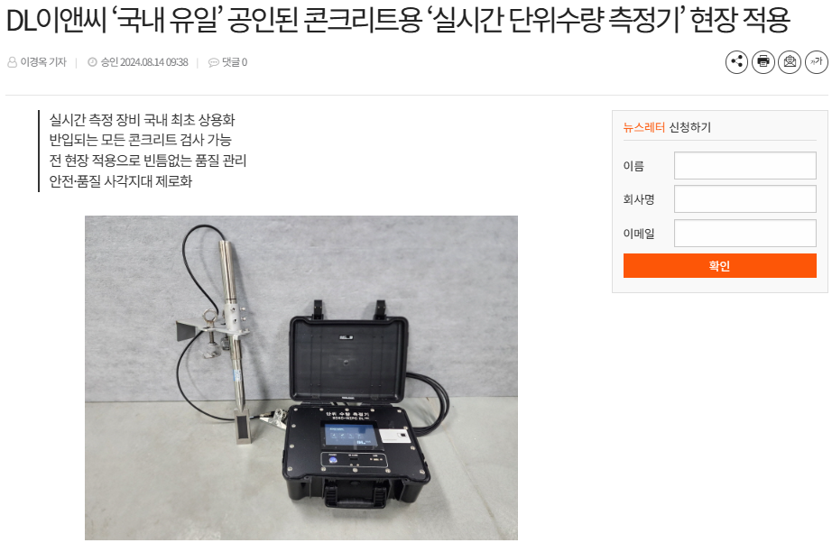
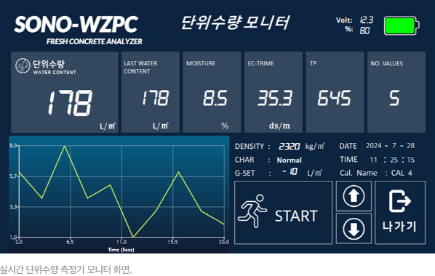
Background of project
Real-time unit water content meter.
All incoming concrete can be inspected
Tight quality control with on-site application
Zero safety and quality blind spots

Slide 8
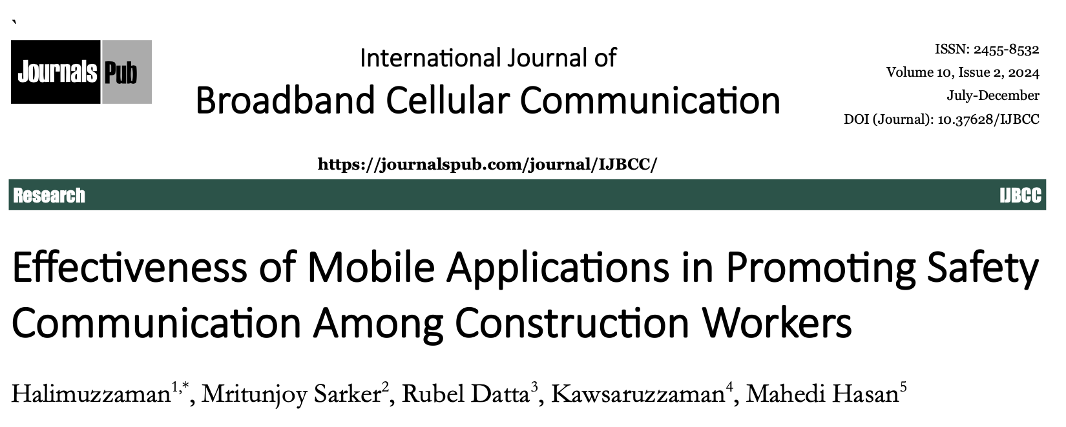
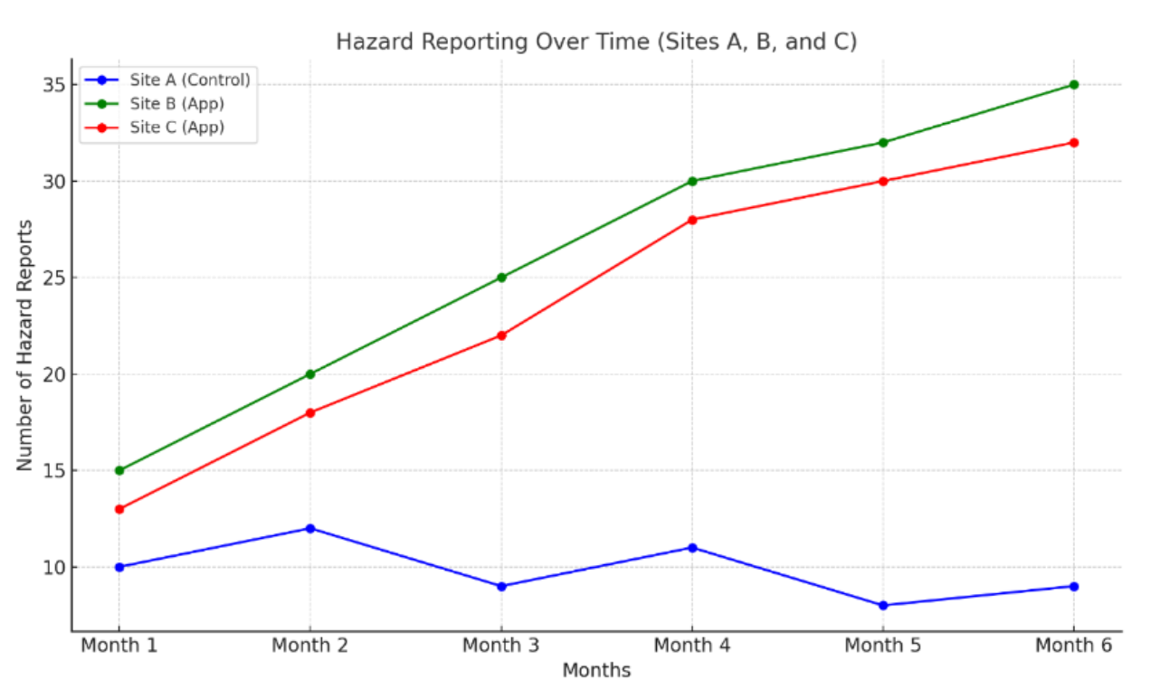
Current Challenges
Effects:
Increased hazard reporting
Reduction in accidents
Improvement in safety culture
----------------------------------------------------------
❌ Limitations:
Reliance on human-centered input
→ potentially inefficient and inconsistent depending on the situation
Lack of standardized procedures

Slide 9
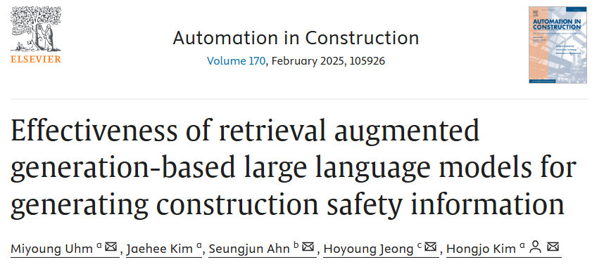
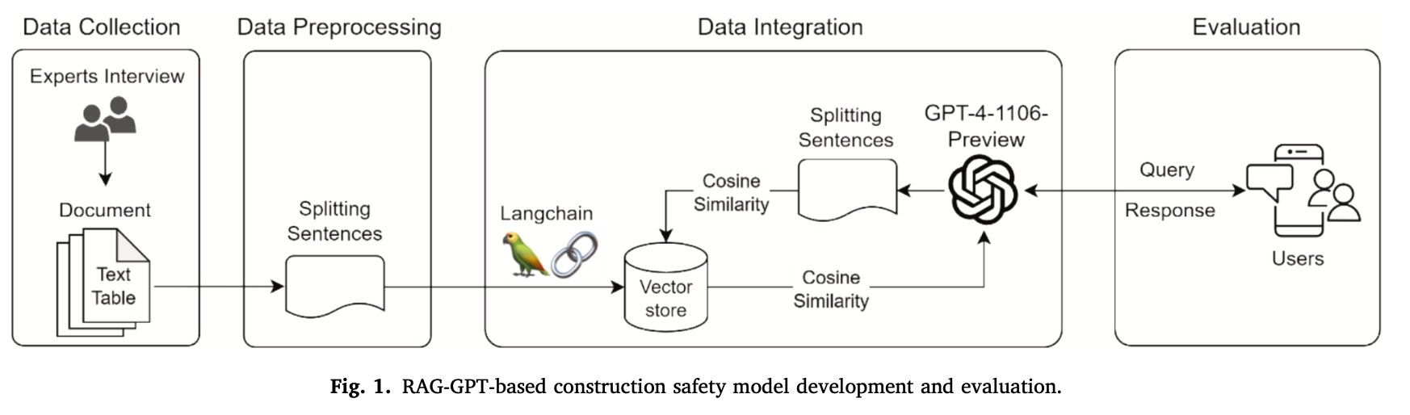
Current Challenges
Effects:
Providing safety guidelines using the GPT-RAG model
------------------------------------------------------
❌ Limitations:
Lack of integration with on-site log data
Inability to incorporate user feedback or respond to emergency situations

Slide 10
Current Challenges
A system that reflects the
real-time nature and dynamic hazard perception
of construction sites is needed

Slide 11
Current Challenges
Limitations of RAG on construction sites
While Retrieval-Augmented Generation (RAG) is useful in general question and answer systems, it has inherent limitations on construction sites where safety and accuracy are critical, such as:
Generated answers may not be factual
Similarity scores (e.g., cosine similarity > 0.3) indicate relevance but do not guarantee the correct answer
High-risk areas such as safety regulations and legal compliance require accuracy and evidence tracking

Slide 12
Current Challenges
Trust requirements in construction QA systems
Faithfulness to provenance | All answers must be clearly based on the original text of the regulation
Extractive rather than generative | Copy and use only validated sentences, avoid spurious generation
Verifiability and transparency | Make it clear to users where your answers come from
Roadmap for the evolution of RAG for construction QA
Step | Explanation | Key features
Step 1 | Basic RAG | LLM + FAISS + Regulation PDF splitting, great for testing purpose Dangerous for live deployment
Step 2 | Enhanced Faithfulness | Highlight top-1 chunk, allow extracted answers only, apply similarity score criteria
Step 3 | Hybrid-QA (LLM + Rules) | Rule-based verification, such as PPE wear rules, LLMs help interpret rules, lowering the risk of false answers
Step 4 | Validated QA systems | Added LLM for answer validation, including automatic correctness scoring, logs, and audit trails

Slide 13
Project Objectives
The research contributions of CREX.AI are as follows:
Implementation of a Construction Safety Manual-Based RAG Chatbot
-> Enhances workers’ access to information by allowing the LLM to provide relevant content from complex documents in real time.
2. Processing of Natural Language Questions Related to Construction Hazards
-> Offers real-time answers to user-generated hazard-related queries, enabling both educational and preventive benefits.
3. Development of a Mobile Interface via FastAPI Backend and Flutter Integration
-> Presents a prototype-level mobile platform that is practically applicable on actual construction sites.
Delivers complex information with clarity
Provides expert answers and regulatory summaries
Offer actionable recommendations with supporting evidence

Slide 14
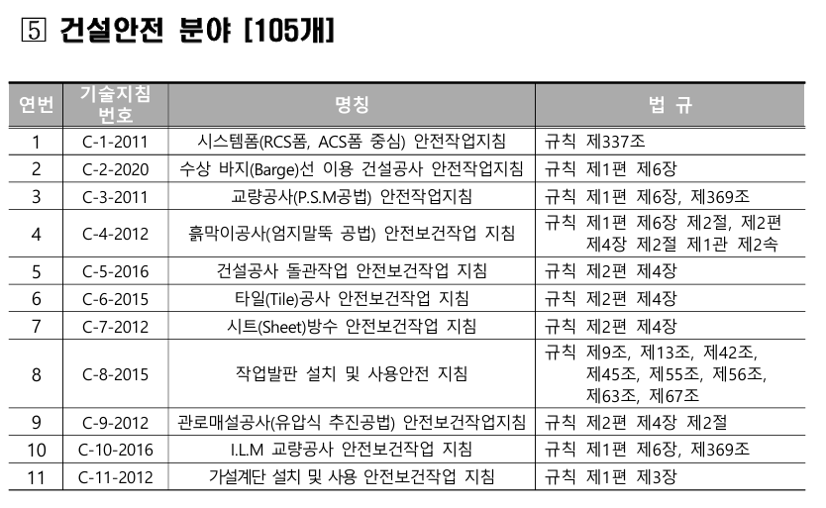


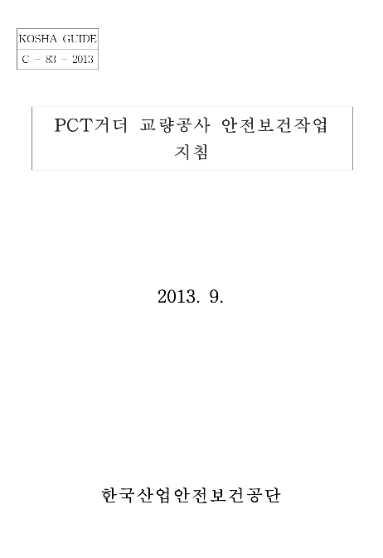


Datasets
We compiled 105 construction-safety documents from the Korea Occupational Safety and Health Agency (KOSHA).

Slide 15
Application Overview
CREX.AI is chatbot delivering INSTANT SAFETY RULES
Main service
A chatbot built on data from the Korea occupational safety and health agency
A GPT-powered chat platform
Uses prompts to generate detailed responses in three stages: regularization, expert answer, and recommendation

Slide 16
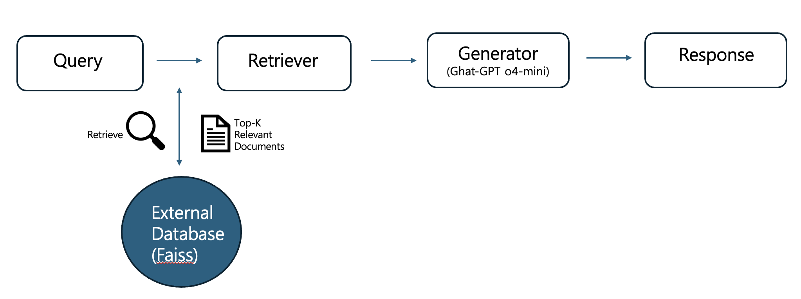

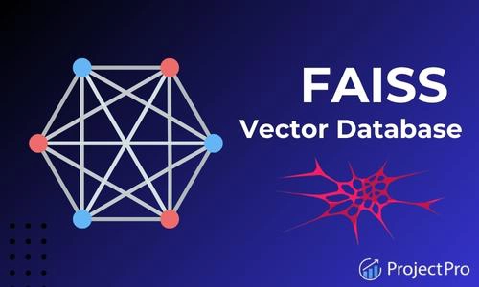

Service Architecture
Query
Retriever
Generator1
(GPT-o4)
Response
Generator2
(Gemma 3)
External Database
(FAISS)

Slide 17
Approaches for Complementation
Approaches | Details
Tool-coupled QA | Integrate calculators, checklists, regulatory DBs, and more with LLM
Fine-tuning small models | Fine-tune specific models with real-world regulatory QA data
Answer validation layer | Second LLM determines factuality of first response
Structured prompts | Limit output in a "source chunk + summary answer" fashion

Slide 18
Evaluation metrics
Provenance fidelity (Faithfulness / Groundedness)
→ Is the answer based on an actual chunk?
Precision@k
→ Are the retrieved chunks actually relevant?
Percentage of similarity criteria met
→ How many responses are above a safe similarity threshold?
Validation pass rate
→ Number of responses determined to be valid during the validation phase

Slide 19
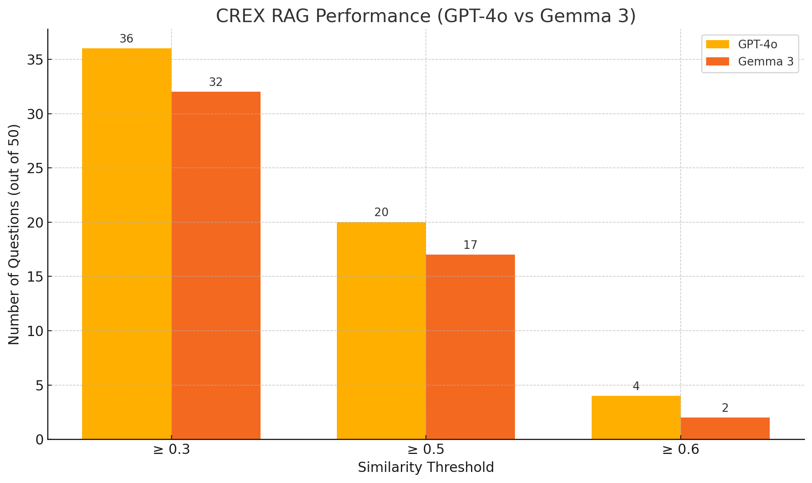
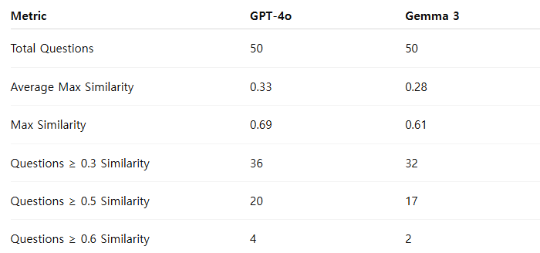
Results

Slide 20


Technology Stack
Backend | Vector DB | Frontend | AI Model
Open AI Embedding (text-embedding-ada-002) | FAISS DB | Home screen with logo | GPT 4o
GPT 4o + RAG for response generation |  | Chat interface | Gemma 3
Sever built with FAST API |  | “Return to home” functionally
 |  | Clear response

Slide 21
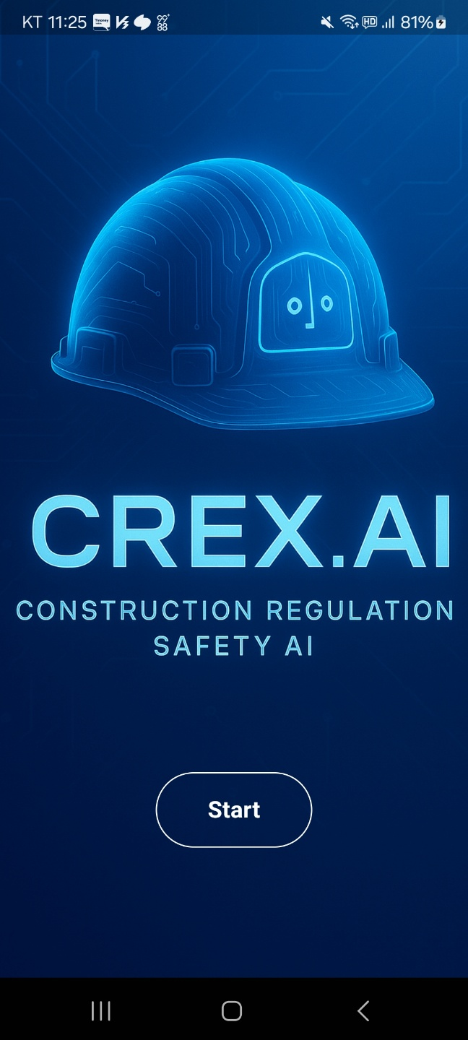
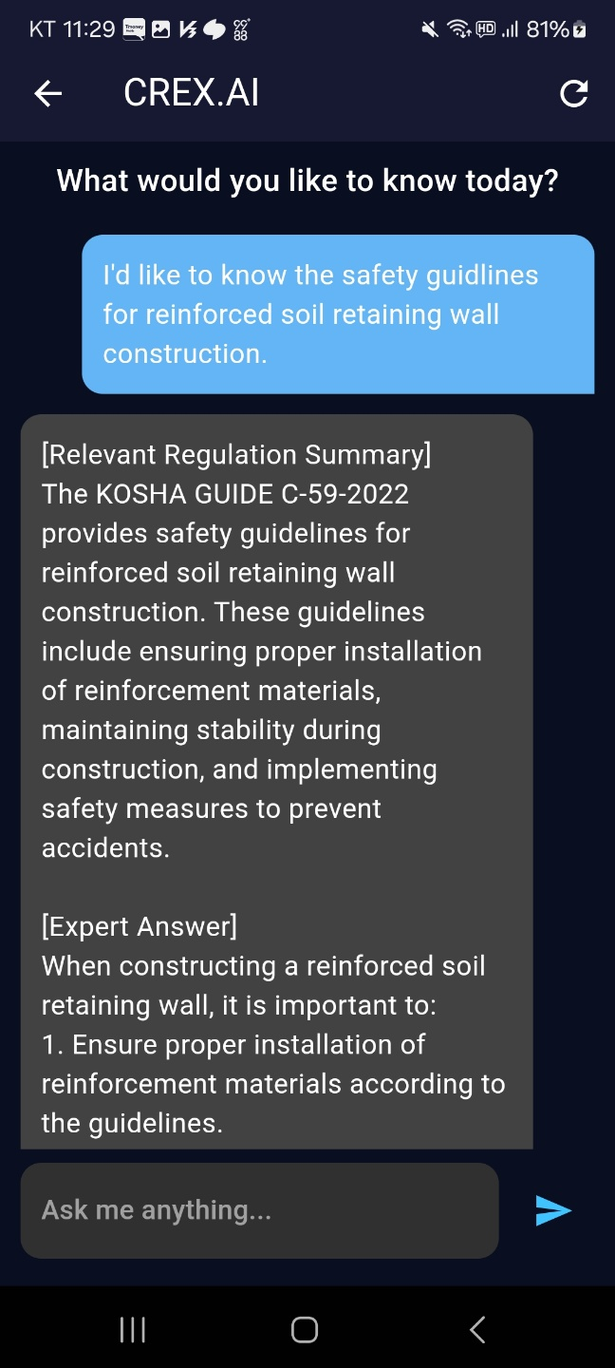
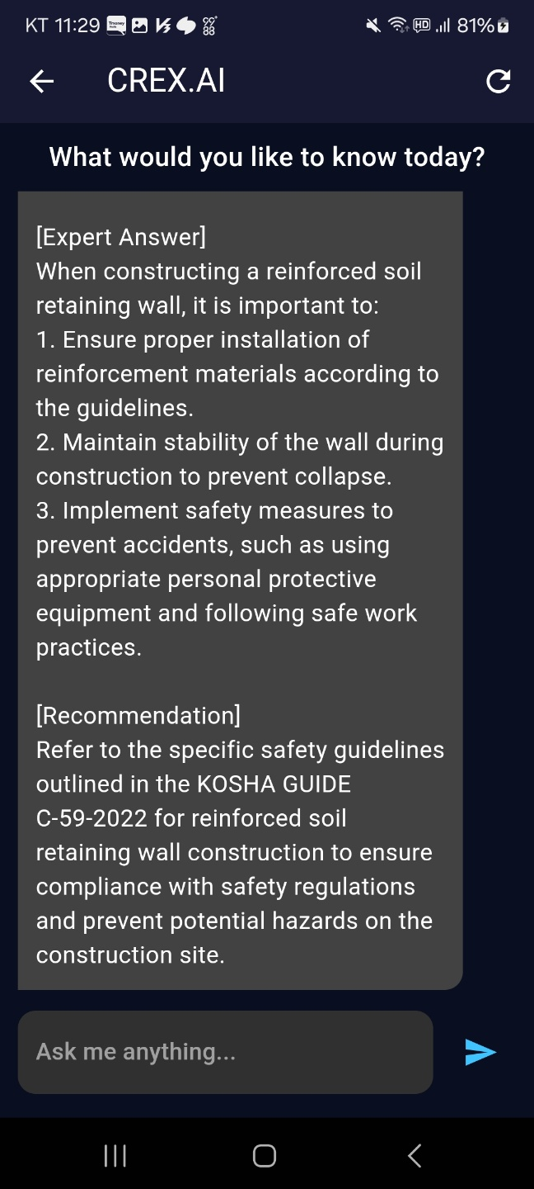
Implementation

Slide 22
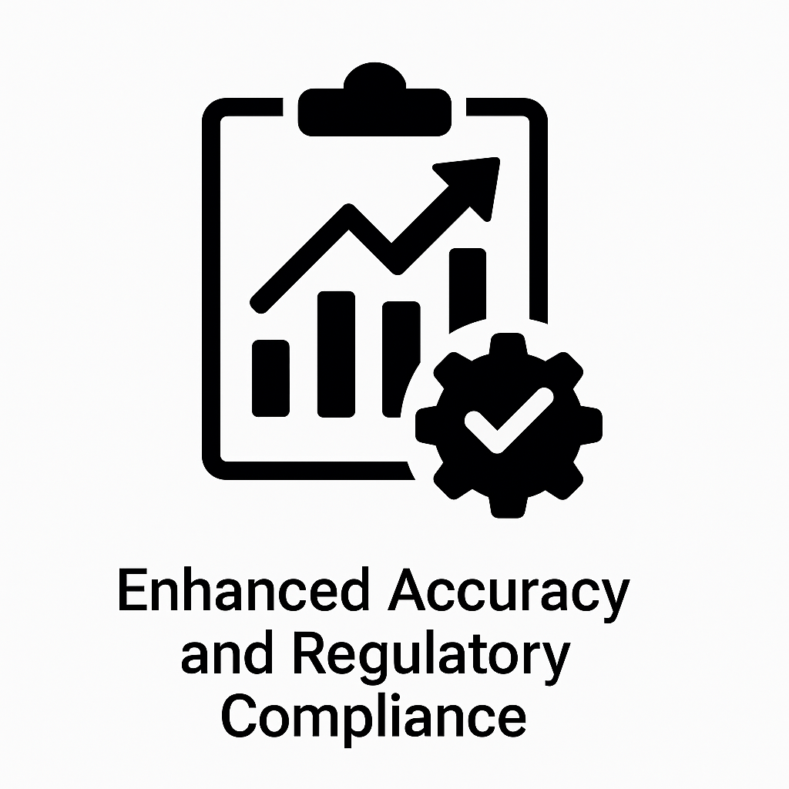
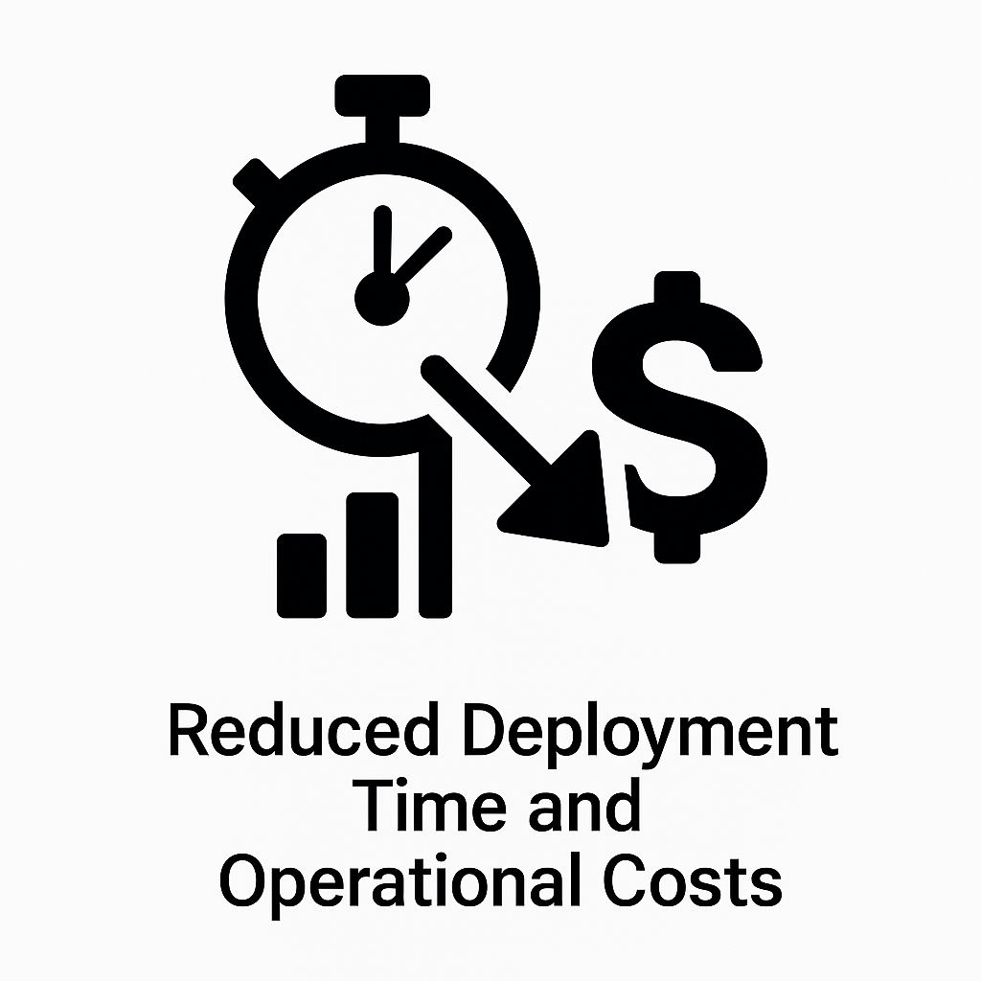
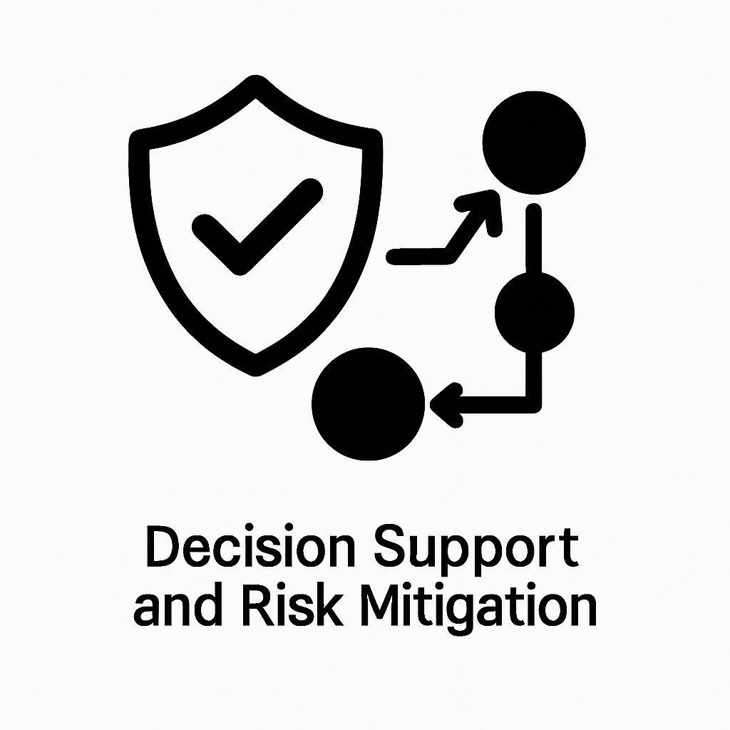
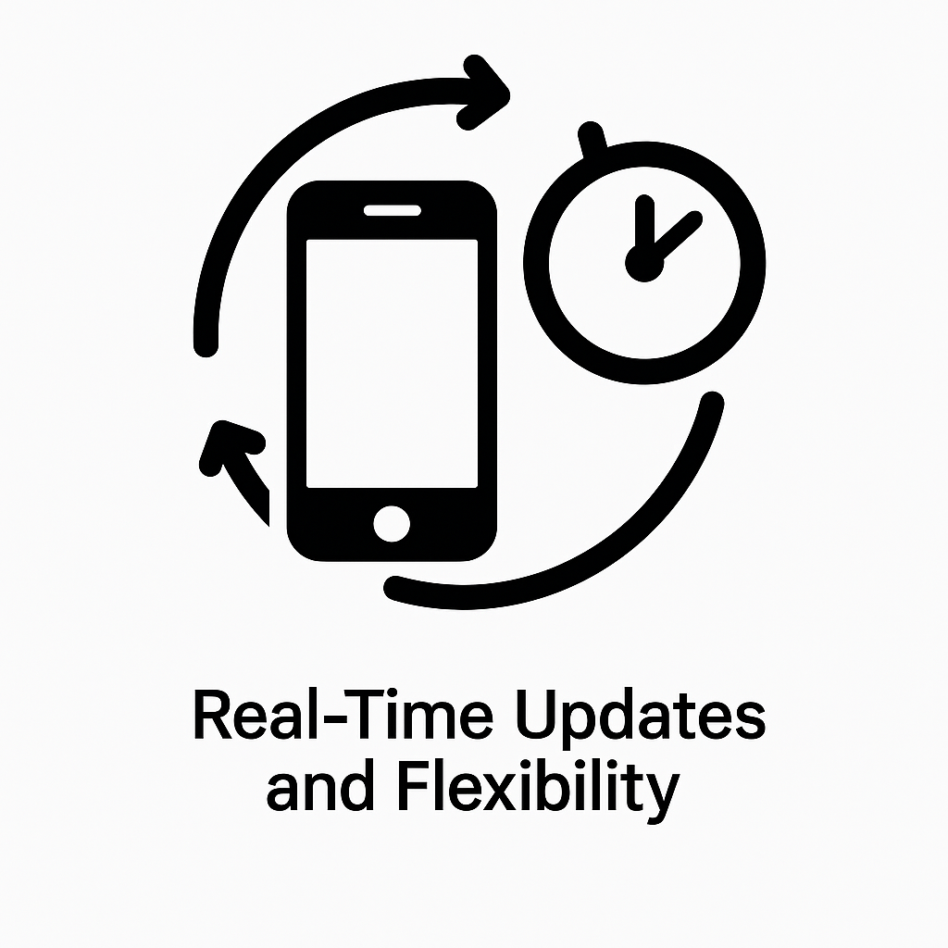
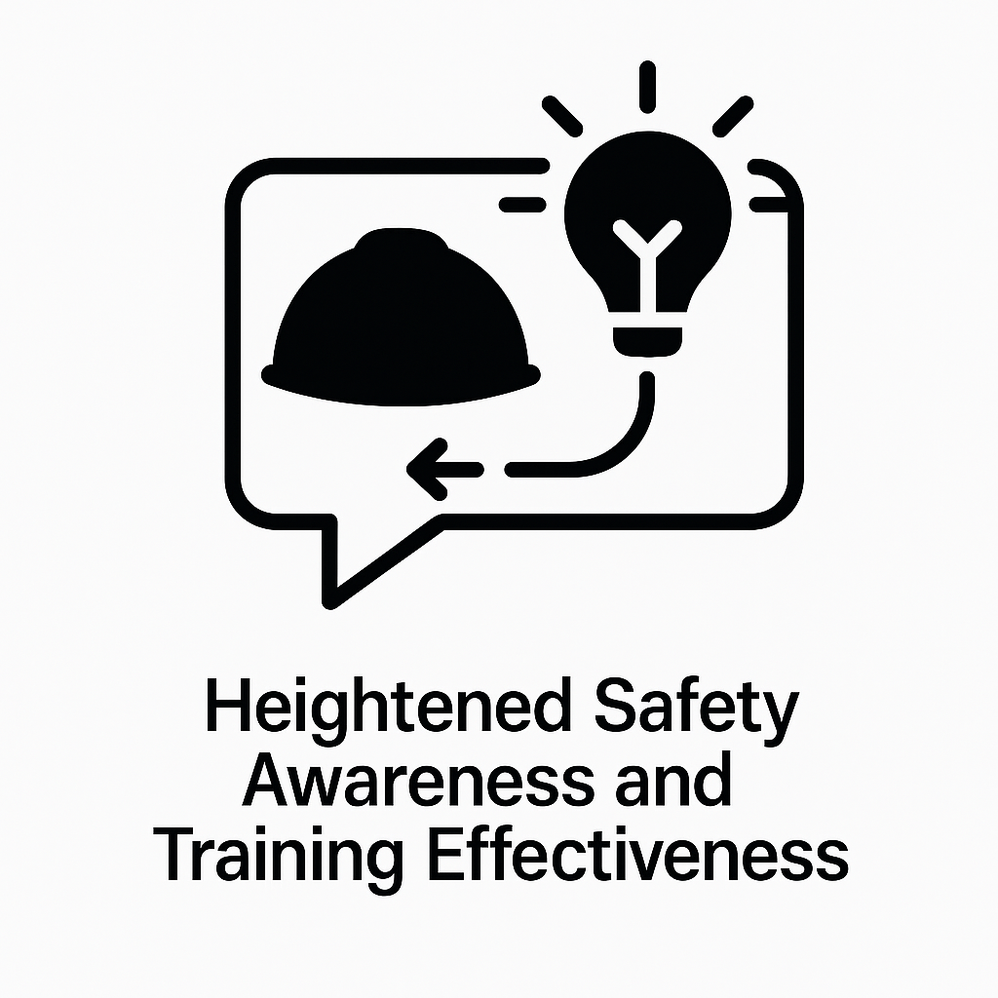
Expectation

Slide 23
Demo video
영상 1분~1분 30초 정도짜리 예상

Slide 24
Conclusion
RAG systems must evolve beyond simple Q&A to support critical domains like construction
They need to function as transparent, verifiable, and rule-based interpretation tools
Step-by-step evolution strategies are required to guide their development
Quantitative evaluation criteria are essential for assessing reliability and field applicability

Slide 25
Feature works
Phase 1 (Current Research)
✔︎ RAG-based construction safety manual chatbot
✔︎ Basic mobile interface implementation
Phase 2 (Follow-up Research)
☐ Automated collection of hazard reports
☐ Analysis of hazard hotspots and report generation
Phase 3 (Expansion Plan)
☐ Integration of voice/video-based input
☐ Connection with real-time hazard detection systems

Slide 26
Thank You For Listening!

